Slide 1





MIS Project
E-commerce Sales Dashboard
Analysis
Data-Driven Sales Strategy with Excel
Turning Raw Data into Business Insights
2025
WPS OFFICE

Slide 2


Introduction
01.
Built an interactive dashboard + Excel project
02.
Based on a real-world E-commerce datasete
03.
Goal: Convert raw transactions into clear, actionable insights
04.
Focus: Revenue Growth & Operational Efficiency
A picture is worth a thousand words
WPS OFFICE

Slide 3

Business Problem
Modern E-commerce companies face challenges:
4
Complex inventory and stock management across locations
Huge volumes of daily sales data across multiple categories & regions
1
5
Tracking diverse payment modes & evolving customer trends
Lack of clear visibility into profitable vs loss-making segments
2
6
Struggle to achieve sales targets consistently
7
Limited insights for effective local & regional marketing campaigns
Difficulty in controlling underperforming products & optimizing pricing
3

Slide 4

Challenges Without Dashboard
No centralized sales performance view
Missing clarity in product vs category profitability
n
Gaps in forecast vs actual sales
Struggles in regional / city-level targeting
Weak payment mode optimization

Slide 5
Project Objective
To design a single source of truth that:
Identifies strengths & weaknesses:
Provides real-time performance insights
Supports smart decisions in sales, inventory & marketing

Slide 6


Data Preparation
Steps followed:
Cleaning & handling missing values
Standardizing product, region, city, payment fields
Transforming raw transactions into structured data
Ready for dashboard reporting

Slide 7



Business Performance Insights
1. Category & Product
Top-performing vs low-performing categories
Best-selling & low-selling products
Action: Boost winners, improve/phase out underperformers
2. Region & State
High vs low revenue regions
State-level insights for inventory & campaigns
3. Company & Pricing
Brand-wise performance comparisons
Pricing trends & impact on sales
Action: Manage partnerships & adjust pricing strategies

Slide 8
Customer & Market Insights
1. Sales Target Achievement
Gap between actual vs target performance
Action: Early shortfall detection & strategy adjustment
2. Payment Modes
Preferences: COD, UPI, Card, Wallets
Action: Optimize checkout flow & offer incentives
3. Demographics (Gender & City)
Male vs Female buying behavior 👥
Top cities driving highest revenue 🏙️
Action: Run targeted promotions & hyperlocal campaigns

Slide 9
Solutions Proposed
Boost Strong Segments → More ads, stock, push
Fix Weak Segments → Offers, combos, drop poor items
Bridge Gaps → Track shortfalls, tweak strategy
Local Marketing → State/region offers, events
Payment Optimization → Promote preferred modes, balance fees
Gender Offers → Campaigns for Male/Female buyers
Gender & city-based targeting
City Focus → Local ads, quick delivery

Slide 10
What It Shows
E-commerce data flow expertise
Dashboard & Excel skills
n
Pattern & insight discovery
Real solutions, not just numbers
Business mindset & storytelling

Slide 11
Dashboard Highlights
Fully interactive, drill-down views
Dynamic filtering (by category, region, payment)
Clear visual storytelling for decision-makers
2025
WPS OFFICE

Slide 12


Excel Project Features
01.
Pivot tables & charts
02.
Dynamic summaries
03.
Scenario analysis
04.
Easy-to-use for managers
WPS OFFICE

Slide 13
Tools & Skills Used
100%
Tools:
Skills:
Excel (cleaning, formulas, pivots, visualization)
Business Analysis
Data Cleaning & Transformation
Sales Performance Tracking
Interactive Dashboards
Storytelling with Data

Slide 14



Key Takeaway & Conclusion
Dashboard converts raw data → clear actions
Scalable for any
E-commerce business
Supports growth, strategy & efficiency
-Proves ability to deliver Data-Driven Decision Support

Slide 15
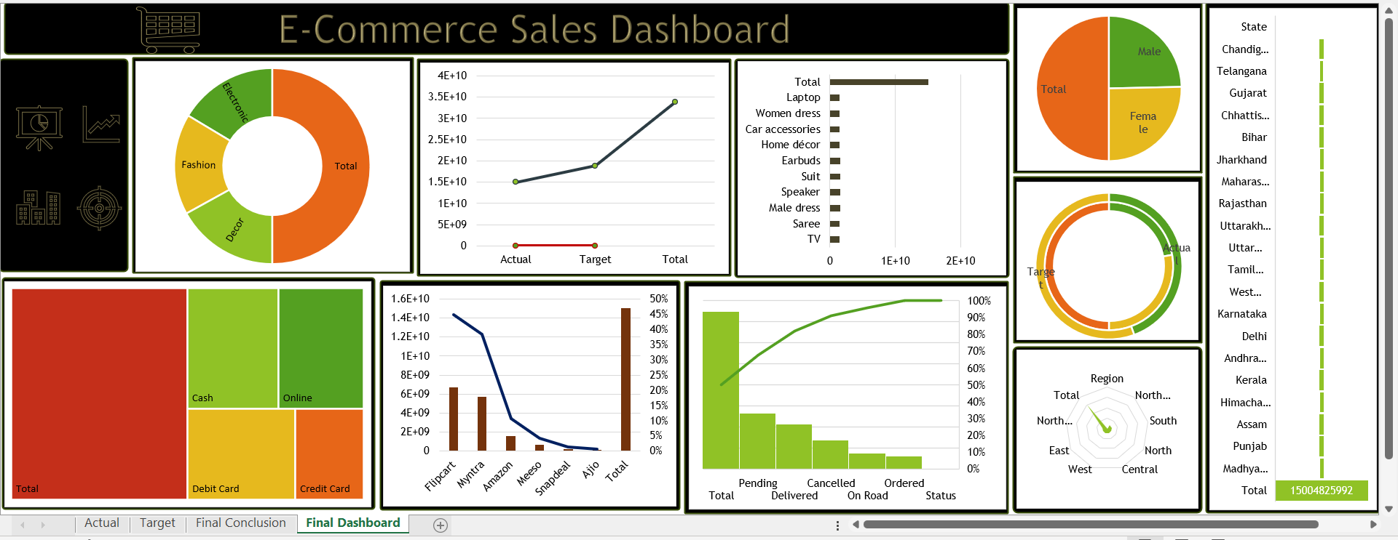
Final Dashboard

Slide 16
Thank You!
Every great presentation is complete with a great audience
— and that’s you!

